Slide 1
Remedial measures for lack of fit
If a simple linear regression model is not appropriate for the data, there are two basic choices
Use a more appropriate model
Use a transformation on the data so that the linear regression model is appropriate for the transformed data.
The first approach may entail a more complex model that could yield better insights, but may also lead to more complex procedures for estimating the parameters.
On the other hand, successful transformations can lead to relatively simple methods of estimation and may involved fewer parameters than a complex model.

Slide 2

Remedial measures for lack of fit
However, transformations can obscure the fundamental interconnection between the variables.
We will first discuss some direct approaches then go over some transformations in detail.
When the regression function is not linear, a direct approach is to modify the regression model by altering the nature of the regression function.
For instance, a quadratic regression function might be used

Slide 3


Remedial measures for lack of fit
Note, to test whether or not to use a quadratic model, we can use the general linear test statistic. The null is that the linear model is sufficient; H_{o}: β₂ = 0.
The full model is
The reduced model is
We can run these models and get SSE(F) and SSE(R), respectively.

Slide 4
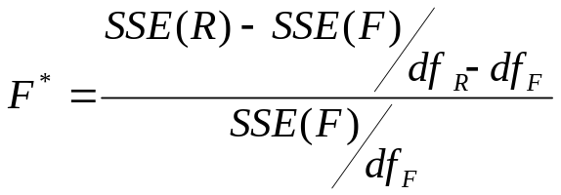
Remedial measures for lack of fit
Recall, the general linear F statistic is
which follows an F distribution when H_{o} is true.
The df_{R} are n-2 and the df_{F} are n-3 (in general it is n-p where p is the number of Betas.
SAS: remedial measures

Slide 5
Remedial measures for lack of fit
When there are outliers that are not the result of recording errors and should not be deleted, an estimation procedure that places less emphasis on such outlying observations can be used.
We will learn one such method, weighted least squares, later.
We will now go over transformations of one or both of the variables that can be used to remedy lack of fit.
Simple transformations of either the response variable Y or the predictor variable X, or both, are often sufficient to make the simple linear regression model appropriate for the transformed data.

Slide 6
Remedial measures for lack of fit
We first consider a transformation for linearizing a nonlinear regression relation when the distribution of the error terms is reasonably close to a normal distribution and the error terms have approximately constant variance.
Thus, this is a transformation for the nonlinear relation only, when the other assumptions hold.
In this situation, transformations on X should be attempted.
The reason why transformations on Y may not be good here is a transformation on Y may cause the error terms to no longer be normal or no longer have constant variance.

Slide 7
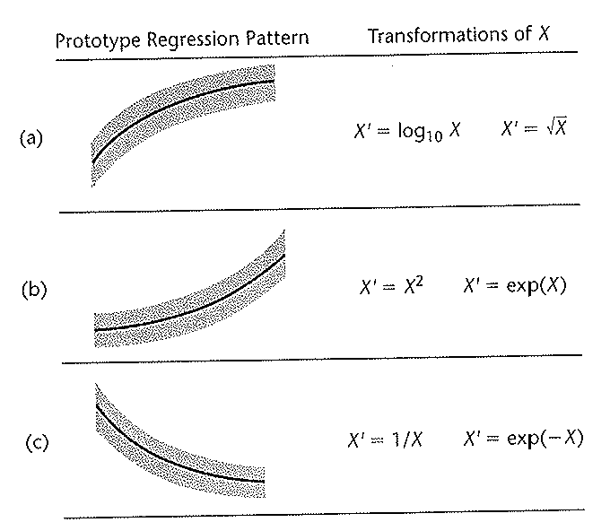
Remedial measures for lack of fit
Below are prototype nonlinear regression relations with constant error variance. There are also corresponding transformations on X that may be able to linearize the regression relationship without affecting the distribution of Y.

Slide 8
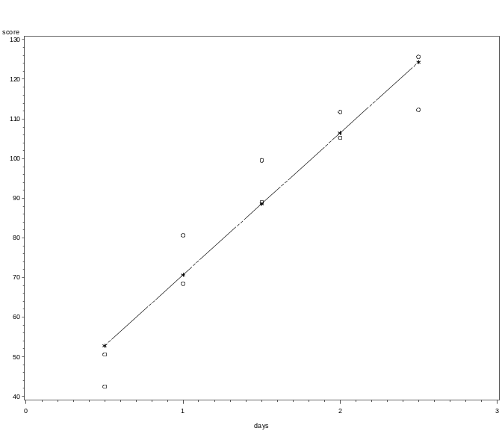
Remedial measures for lack of fit
Consider an example where we study the relationship between the number of days of training received (X) on a performance score (Y).
A scatter plot of the data shows that, while the variability at the different X levels appears to be constant, the relationship seems to be curvilinear. This plot has the linear regression line fit to it. (days on x-axis, score on y-axis).

Slide 9
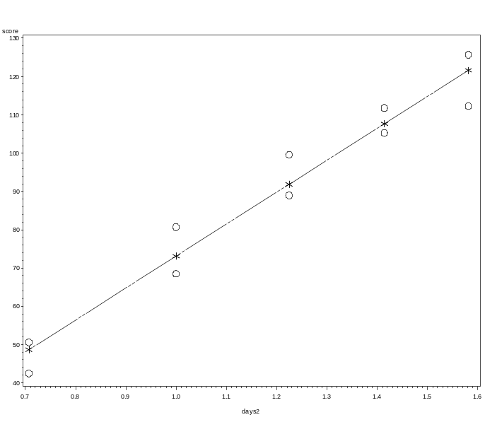
Remedial measures for lack of fit
Based on the prototype plot, we will try a square root transformation, where X’ = the square root of X.
Below is a scatter plot using the transformed variable X’, again with the linear regression line fit to it. (square root of days on x-axis, score on y-axis).

Slide 10

Remedial measures for lack of fit
The fitted regression function of the transformed data is
The r-squared for this fit is .9545 (it was .9256 for the untransformed fit).
We next examine the plot of residuals against the transformed X’ to verify we have linearity as well as constant variance.

Slide 11
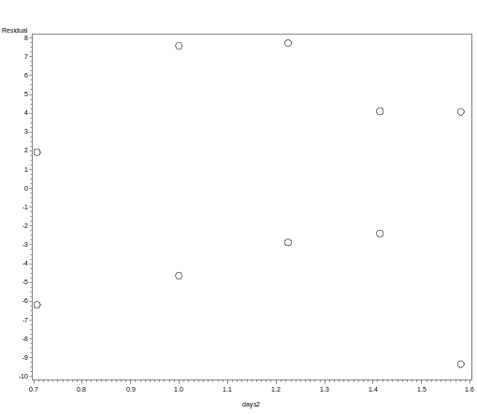
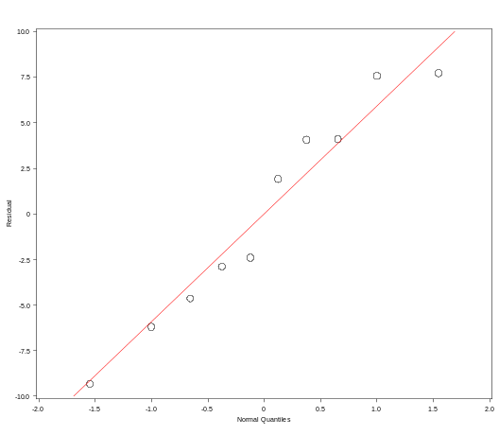
Remedial measures for lack of fit
There is no evidence of lack of fit or unequal variance. So we next create a normal probability plot to verify normality of the error terms.

Slide 12
Remedial measures for lack of fit
No strong indications of substantial departures from normality are indicated by this plot.
The tests for normality are also non-significant, thus we do not reject the null of normality. The simple linear regression model appears to be appropriate for the transformed data.
SAS: remedial measures

Slide 13
Remedial measures for lack of fit
Unequal variances and nonormality of the error terms frequently appear together.
To remedy these violations of assumptions, we need a transformation on Y, since the shapes and spreads of the distributions of Y need to be changed.
Such a transformation on Y may also at the same time help to linearize a curvilinear relation.
At other times, a simultaneous transformation on X along with Y may be needed to obtain or maintain a linear relation.

Slide 14
Remedial measures for lack of fit
Frequently, the nonormality and unequal variances violations take the form of increasing skewness and increasing variability of the error terms as the mean response E{Y} increases.
For example, in a regression of yearly household expenditures for vacations (Y) on household income (X), there will tend to be more variation for high-income households than low-income ones who consistently tend to spend much less on vacations.
There will also be greater skewness for high income households as a result of some very large yearly vacation expenditures.

Slide 15
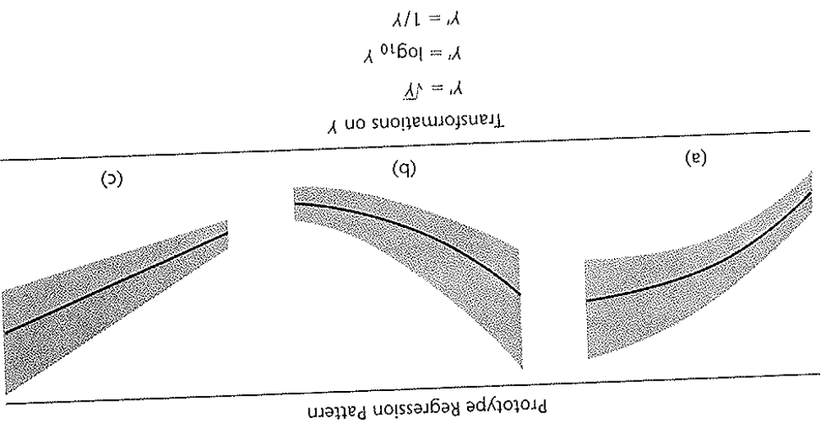
Remedial measures for lack of fit
Below are some prototype regression relations where the skewness (non-normality) and error variance increases or decreases as E{Y} increases and some transformations on Y that may be helpful
Here, simultaneous transformations on X may be needed.

Slide 16
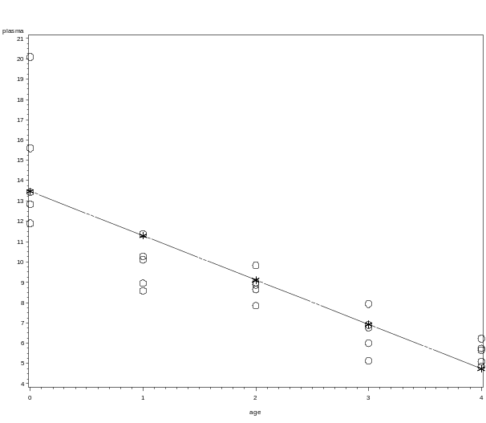
Remedial measures for lack of fit
Consider an example where we examine the relationship between age (X) and the level of a polyamine in children (Y).
A scatter plot indicates a curvilinear relationship, as well as greater variability for younger children than older one. (age on x-axis, plasma level on y-axis).

Slide 17
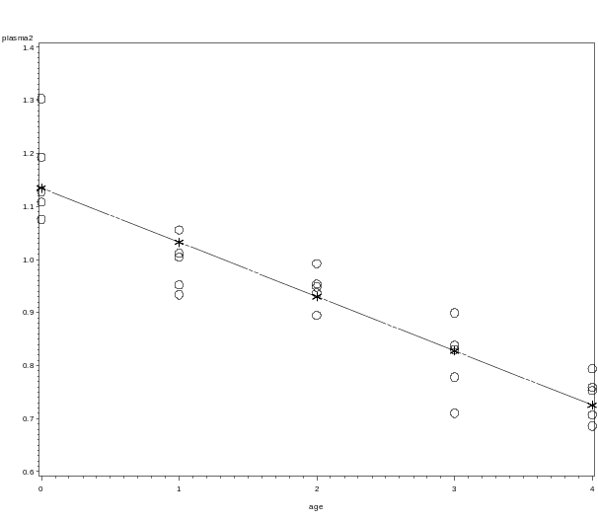
Remedial measures for lack of fit
On the basis of the prototype regression pattern, we will try the transformation Y’ = log₁₀(Y).
Looking at a scatterplot of the transformed data, both the variability at different age levels has become reasonably constant and the relationship is linear. (age on x-axis, log₁₀ (plasma level) on y-axis).

Slide 18

Remedial measures for lack of fit
The fit of the model with the transformed data is
The r-squared for this fit is .8535 (it was .7532 for the untransformed fit).
We next examine the plot of residuals against X to verify we have linearity as well as constant variance.

Slide 19
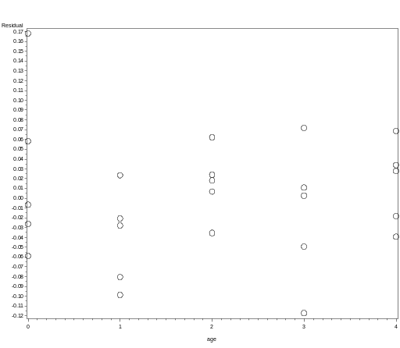
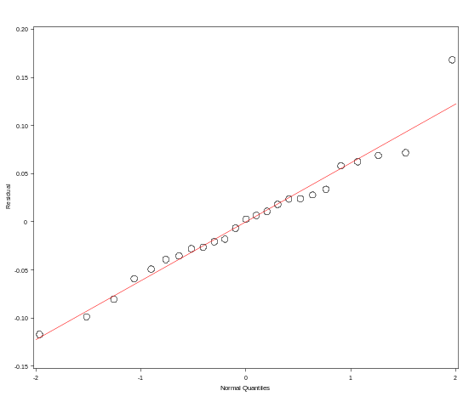
Remedial measures for lack of fit
There is no evidence of lack of fit or unequal variance. So we next create a normal probability plot to verify normality of the error terms.

Slide 20
Remedial measures for lack of fit
No strong indications of substantial departures from normality are indicated by this plot.
The tests for normality are also non-significant, thus we do not reject the null of normality.
Thus the simple linear regression model appears to be appropriate for the transformed data.
SAS: remedial measures

Slide 21
Remedial measures for lack of fit
It may be difficult to determine from diagnostic plots which transformation of Y is most appropriate for correcting non-normality, unequal variances, and/or non-linearity.
The Box-Cox procedure automatically identifies a transformation from the family of power transformations on Y.
The family of power transformations on Y is of the form
Y’ = Y^{λ}
where λ is a parameter to be determined from the data.

Slide 22
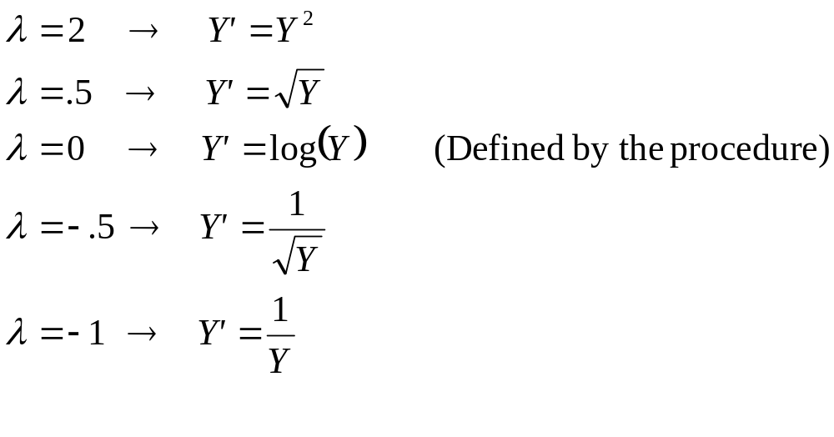
Remedial measures for lack of fit
This family encompasses the following simple transformations:
The normal error regression model with the response variable a member of the power transformations becomes
Y_{i}^{λ} = β₀ + β₁X_{i} + ε_{i}

Slide 23
Remedial measures for lack of fit
Note that the regression model includes an additional parameter, λ, which needs to be estimated.
The Box-Cox procedure uses the method of maximum likelihood estimation to estimate λ as well as the other parameters β₀, β₁, and ε_{i}
In this way the Box-Cox procedure identifies λ(hat), the mle of λ, to use in the transformation.
Since some software packages do not automatically provide the Box-Cox mle λ(hat), a simple procedure for obtaining λ(hat) can be used instead.

Slide 24
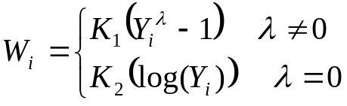
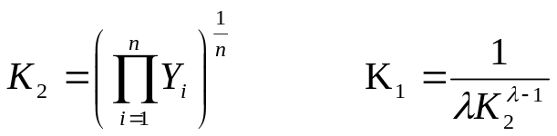
Remedial measures for lack of fit
This procedure involves a numerical search in the range of potential λ values; for example λ = -2, λ = -1.75, …, λ = 1.75, λ = 2.
For each λ value, the Y_{i}^{λ} observations are first standardized so that the scale of the error sum of squares does not depend on the value of λ.
where
Note that K₂ is the geometric mean of the Y_{i} observations.

Slide 25
Remedial measures for lack of fit
Once the standardized observations W_{i} have been obtained for a given λ value, they (instead of the Y_{i}) are regressed on the predictor variable X and the error sum of squares SSE is obtained.
It can be shown that the maximum likelihood estimate λ(hat) is the value of λ which minimizes the SSE.
If desired, a finer search can be conducted in the neighborhood of the λ value which produced the smallest SSE.
However, the Box-Cox procedure ordinarily is used only to provide a guide for selecting a transformation, so overly precise results are not needed.

Slide 26

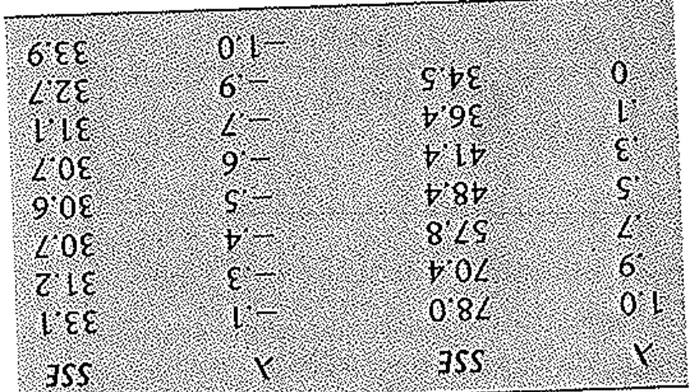
Remedial measures for lack of fit
The below table contains the Box-Cox results for the plasma level example. Selected values of λ from -1 to 1 were chosen. For each λ the observations Y were transformed to W and the linear regression of W on X was fit.
For example, for λ=.5, we have and then we regress the W on X. For this fitted regression, SSE = 48.4. The transformation that leads to the smallest SSE is λ = -.5, which leads to an SSE of 30.6.

Slide 27
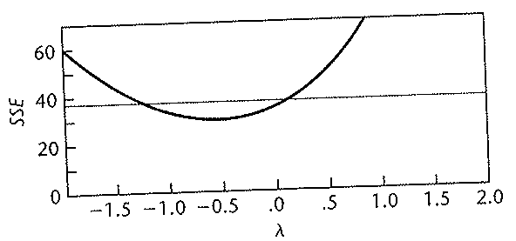
Remedial measures for lack of fit
The figure below contains the SAS-JMP Box-Cox results for the plasma example. It consists of a plot of SSE as a function of λ.
From the plot, it is clear that a value of λ = -.5 is indicated. However, the SSE as a function of λ is pretty stable in the range from near 0 to -1, so the earlier choice of the logarithmic transformation Y’ = log₁₀(Y), which corresponds to λ = 0, is not unreasonable.

Slide 28
Remedial measures for lack of fit
One reason the logarithmic transformation may be chosen instead of using λ = -.5 is the ease of interpreting it.
Note that λ = 0 actually corresponds to using log_{e} and not log₁₀.
However, the use of the logarithms to base 10 rather then the natural logarithms does not affect the appropriateness of the logarithmic transformation.

